Slide 1
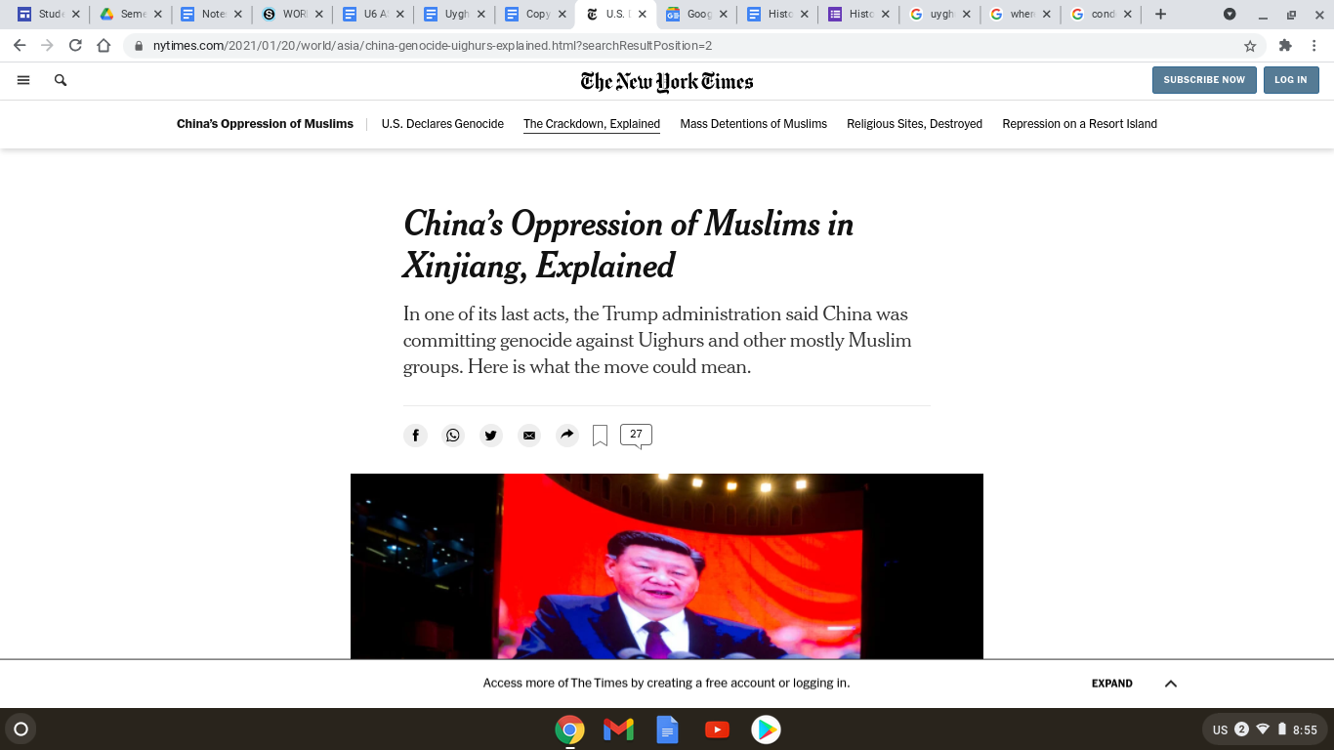
China’s Oppression of Muslims in Xinjiang, Explained
https://www.nytimes.com/2021/01/20/world/asia/china-genocide-uighurs-explained.html?searchResultPosition=2

Slide 2
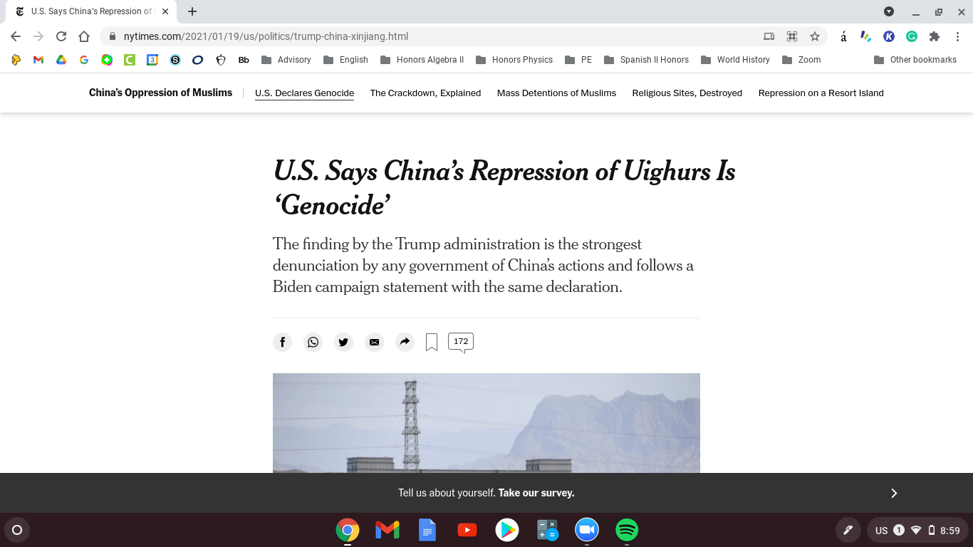
U.S. Says China’s Repression of Uighurs Is ‘Genocide’ U.S. Says China’s Repression of Uighurs Is ‘Genocide’
https://www.nytimes.com/2021/01/19/us/politics/trump-china-xinjiang.html

Slide 3
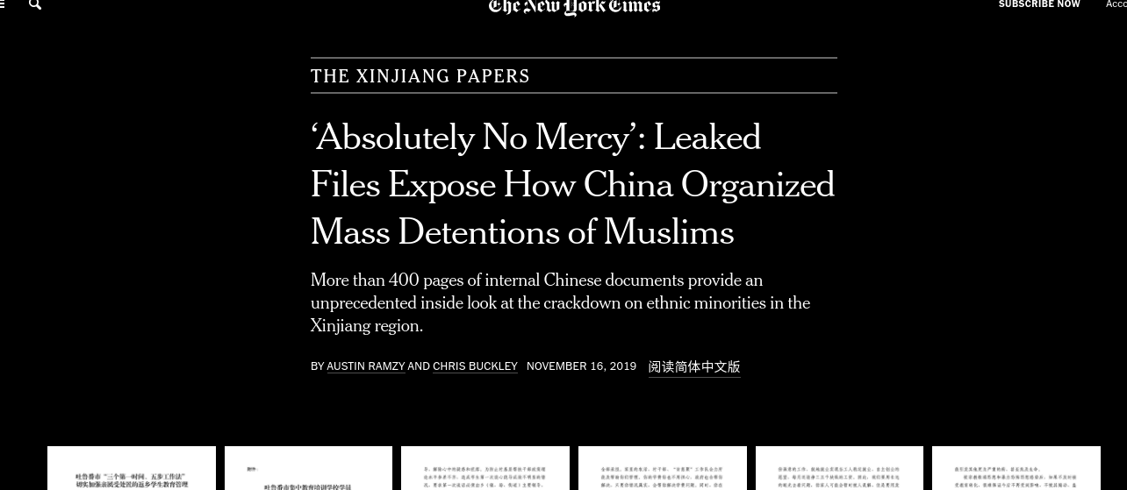
‘Absolutely No Mercy’: Leaked Files Expose How China Organized Mass Detentions of Muslims
https://www.nytimes.com/interactive/2019/11/16/world/asia/china-xinjiang-documents.html

Slide 4
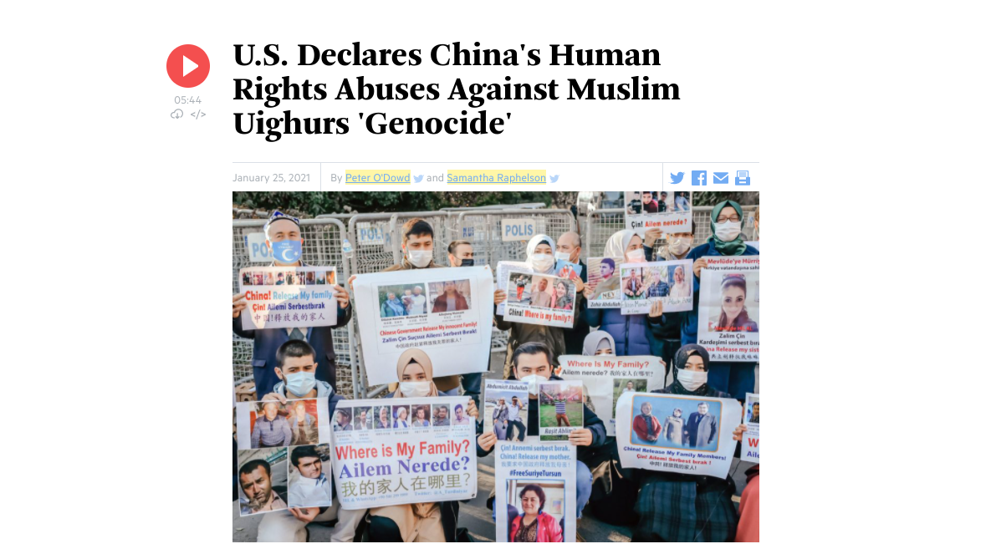
U.S. Declares China's Human Rights Abuses Against Muslim Uighurs 'Genocide
https://www.wbur.org/hereandnow/2021/01/25/china-uighurs-genocide

Slide 5
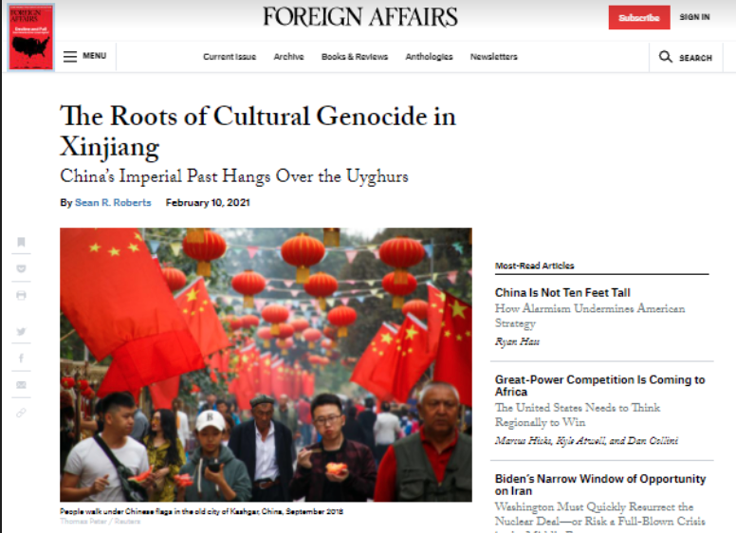
Dutch parliament: China's treatment of Uighurs is genocide
https://www.foreignaffairs.com/articles/china/2021-02-10/roots-cultural-genocide-xinjiang

